Slide 1
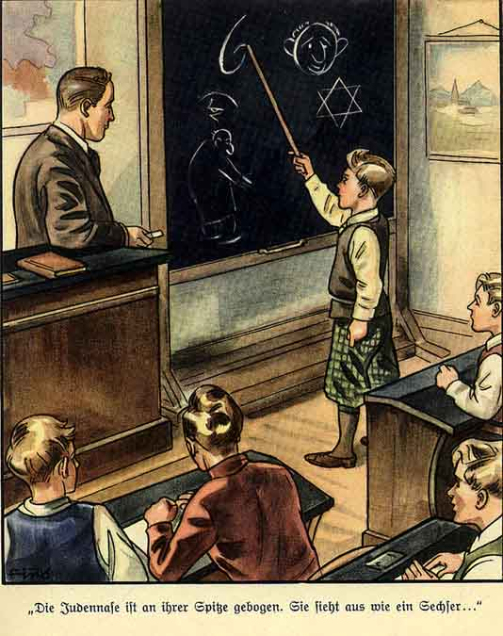

Slide 2
Due Dates
Thursday, 4/30
*World War II Test (Orange Notes)
*Warm-Ups
*Optional Extra Credit Worksheet

Slide 3
The Holocaust

Slide 4
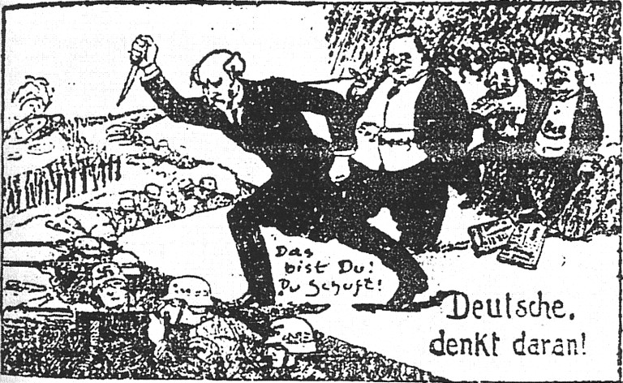
1. History
The Nazis blamed the Jews for the Great Depression and Germany’s loss in World War One.

Slide 5
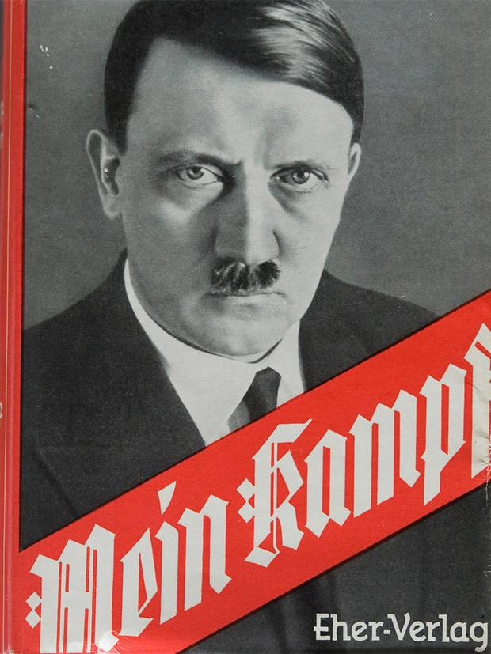
1. History
b. Hitler wrote of his
hatred of the Jews
in his autobiography
Mein Kamph (My
Struggle).

Slide 6
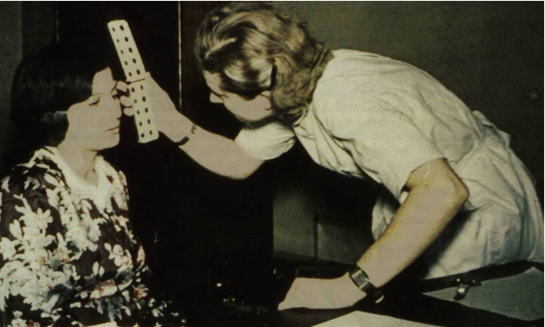

Slide 7
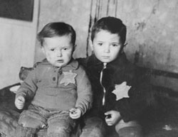
2. 1933-1938
a. The Nuremburg Laws segregated Jews and prohibited
them from marrying or having children with “pure”
Germans.

Slide 8
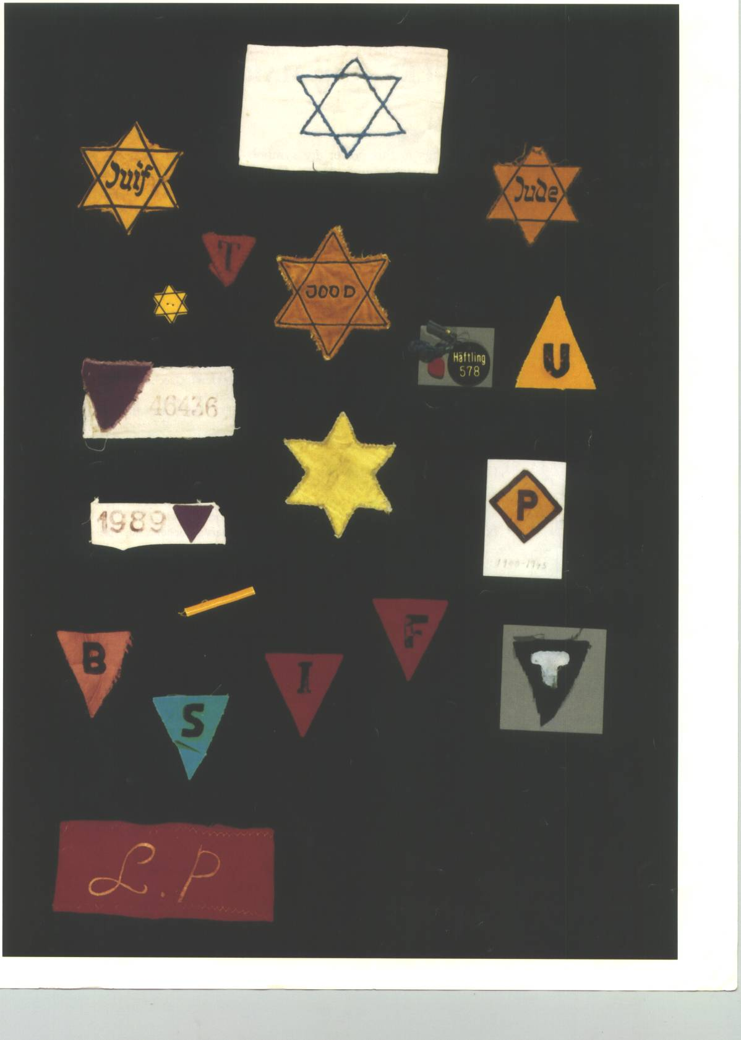
2. 1933-1938
Gypsies, Communists,
Criminals, Homosexuals
and the Handicapped
were also among the groups
to be segregated but
allowed to live and work in
Germany.
The Nazis forced people to wear an identification badge at all times.

Slide 9
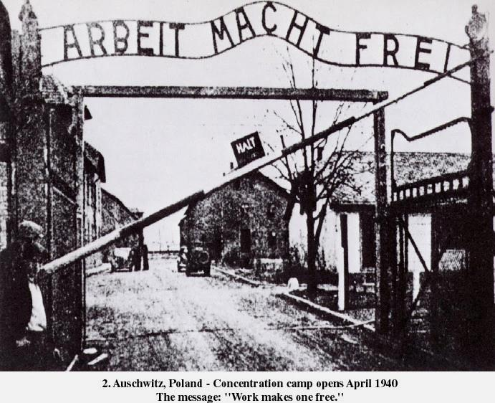
The way we selected our victims was as follows: we had two doctors on duty at Auschwitz to examine the incoming trains of prisoners. The prisoners would be marched by one of the doctors who would make spot decisions as they walked by. Those who were fit for work were sent into the Camp. Others were sent immediately to be executed. Children were often exterminated, since by reason of their youth they were unable to work. Still another improvement we made was that at other camps the victims almost always knew that they were to be exterminated. At Auschwitz we tried to fool the victims into thinking that they were to be bathed or showered before starting work. Very frequently women would hide their children under their clothes but of course when we found them we would send the children in to be exterminated. We were required to carry out these exterminations in secrecy but of course the foul and nauseating stench from the continuous burning of bodies permeated the entire area and all of the people living in the surrounding communities knew that exterminations were going on at Auschwitz. — Rudolf Hoss Auschwitz camp commandant, Nuremberg testimony.

Slide 10
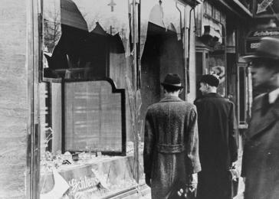
3. Ghettos
On November 9th, 1938, 30,000 Jews were captured and taken to special parts of cities called Ghettos.

Slide 11
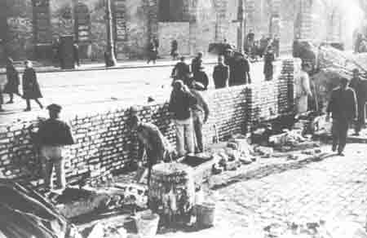
3. Ghettos
b. Meant to keep the Jews in one place.

Slide 12
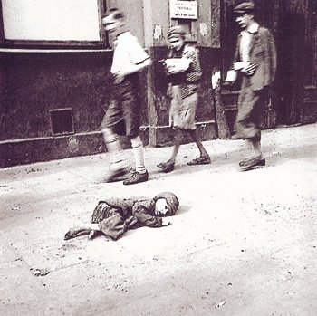
3. Ghettos
c. Overcrowded and
full of disease.

Slide 13
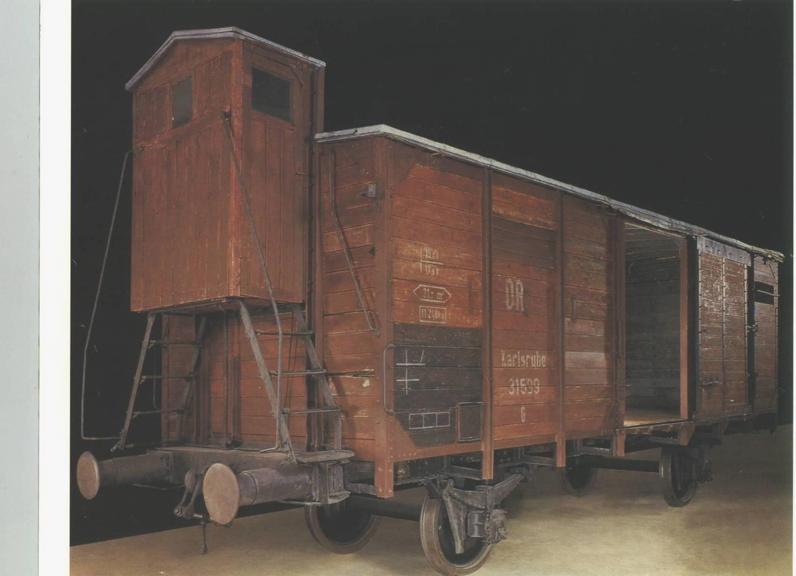
4. Concentration Camps
Sent from the Ghettos to Camps by cattle car.

Slide 14
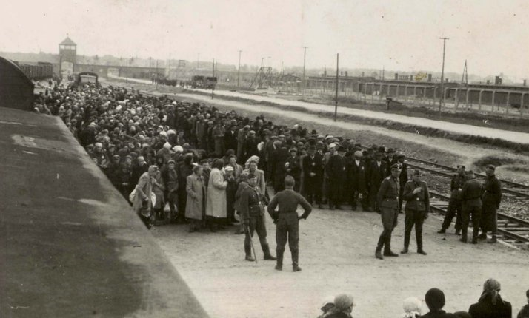

Slide 15
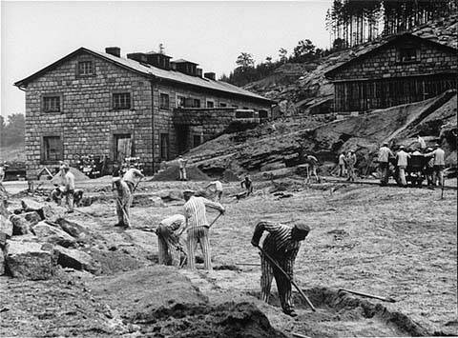
4. Concentration Camps
b. Forced to work.

Slide 16
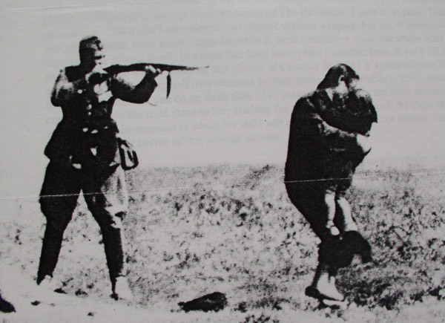
4. Concentration Camps
c. Those who couldn’t work were killed instantly.

Slide 17
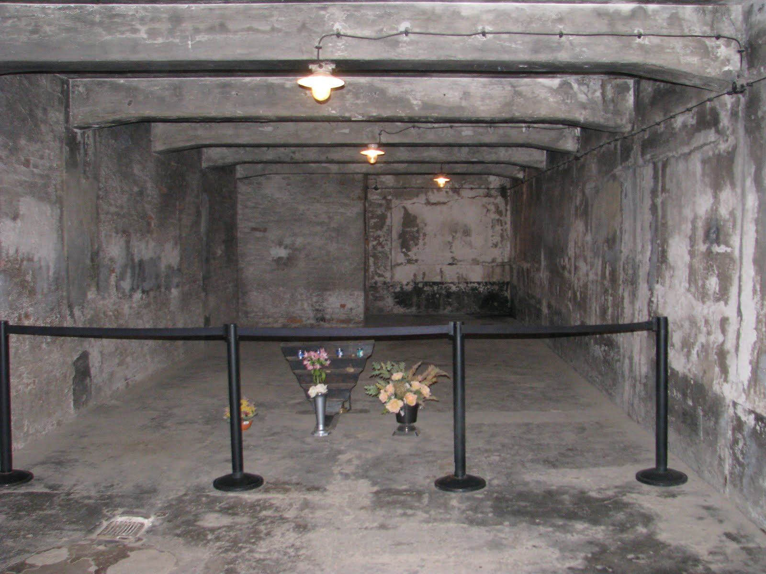
The Gas Chamber at Auschwitz

Slide 18
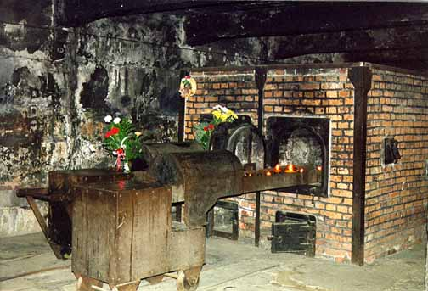
The ovens used to burn the bodies at Auschwitz

Slide 19
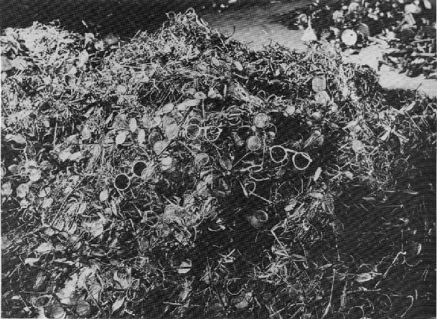
Eyeglasses taken from prisoners at the Dachau camp

Slide 20
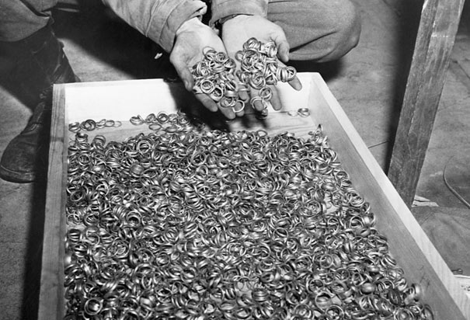
Wedding rings taken from victims at Auschwitz

Slide 21
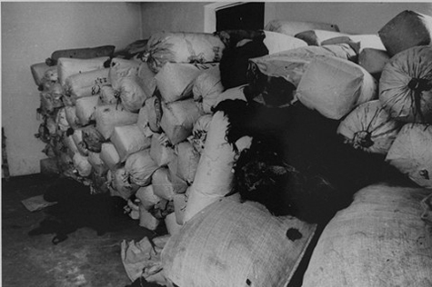
Some of the 7 tons of hair from prisoners at Auschwitz that was used for mattresses and pillows across Germany.

Slide 22
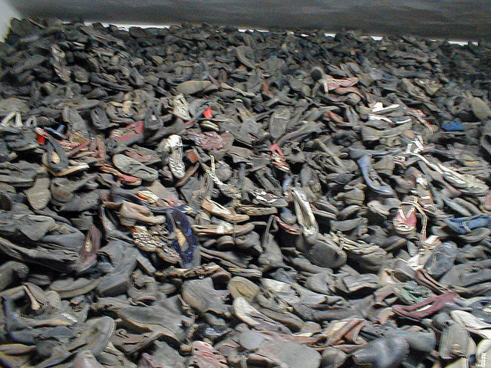
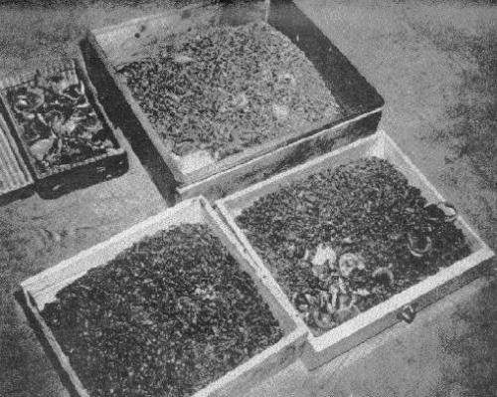
Shoes
Gold Teeth and Fillings

Slide 23
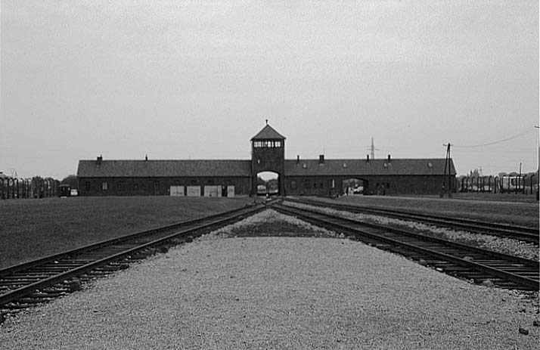
4. Concentration Camps
d. Auschwitz was the biggest. 1,100,000 people
were murdered here.

Slide 24
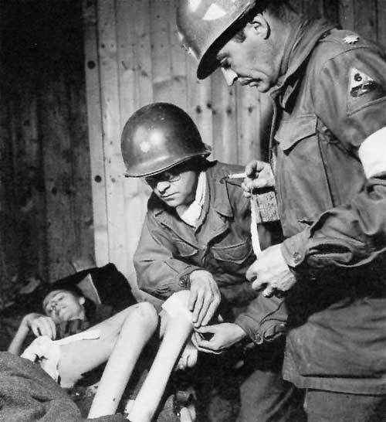
5. Liberation
On April 11th, 1945 the American Army liberated the Buchenwald camp.
American doctors treat a liberated prisoner.

Slide 25
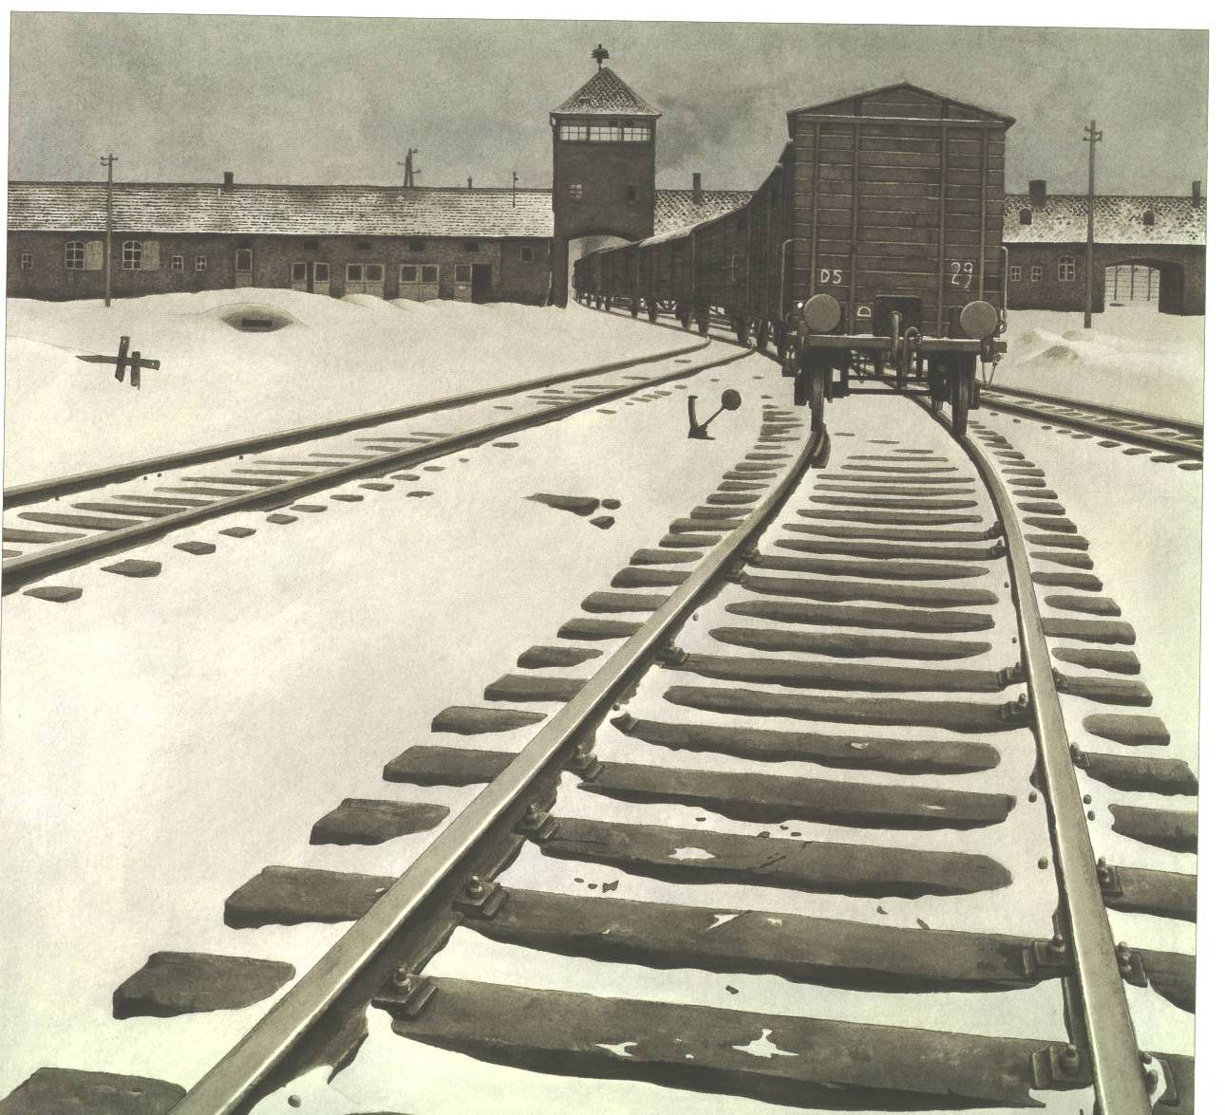
5. Liberation
b. Between 6 and 7 million Jews were murdered
in the camps.
c. 7-8 million non-Jews were murdered in the
camps.

